Slide 1
Image Encryption using Neural Cryptography
Rohith.V – RA1411003010245
Sabari Prasanth.G – RA1411003010354

Slide 2
Algorithm

Slide 3
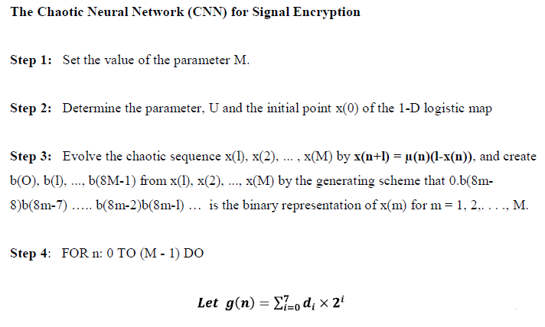
Algorithm

Slide 4
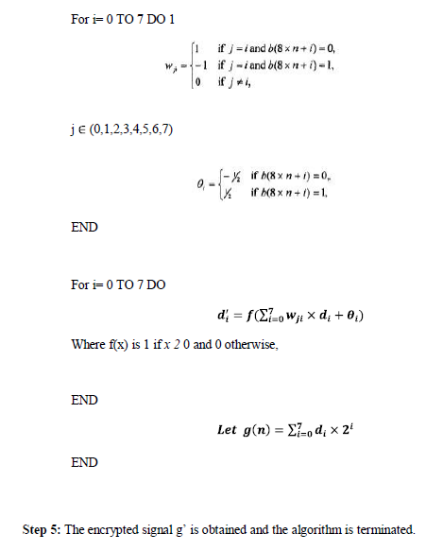
Algorithm

Slide 5
Algorithm

Slide 6
Encryption

Slide 7

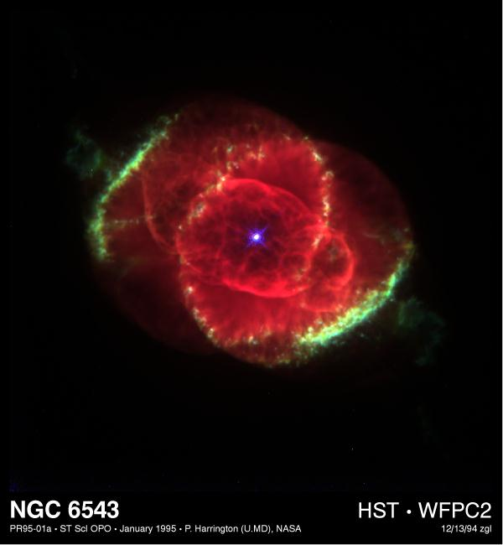
Procedure
Load the image to be encrypted
Image after cropping for efficient encryption.

Slide 8
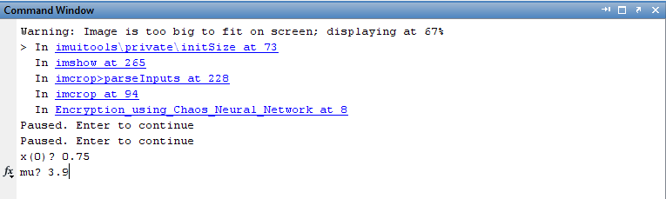
Procedure
Give values for x(0) and mu.
They are the encryption cipher.

Slide 9

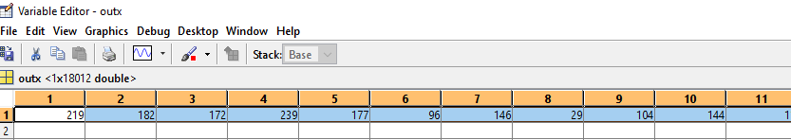
Procedure
Obtain the encrypted image by following the algorithm specified earlier.
Also convert the image into matrix form for better communication.
Encrypted image.
Value of encrypted image.

Slide 10
Decryption

Slide 11
Procedure
Input the encrypted image as a matrix .

Slide 12
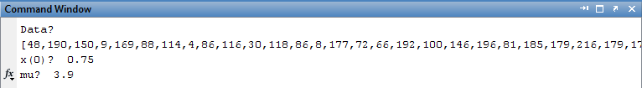
Procedure
Input the cipher key parameters- x(0) and mu

Slide 13

Procedure
Get the decrypted image.
Decrypted image.

